Slide 1
Basics of Fatigue Testing

Slide 2
Agenda
Introduction to Fatigue
Fatigue testing parameters
Fatigue testing
Stress controlled fatigue testing
Strain controlled fatigue testing
S-N curves
Coffin-Manson plots
Fatigue crack growth mechanism

Slide 3
Introduction to Fatigue
Metal subjected to repetitive loading conditions accompanied with vibrations or fluctuating stress
Failures occur under dynamic loading conditions – because these failures occur only after a considerable period of service
Examples of frequent fatigue failures are; automobiles, aircraft, compressors, pumps, turbines, etc.,
Fatigue failures happen without any warning
Fatigue failures are in general brittle in nature – no gross deformation is observed
Fracture surface will be in general normal to the loading axis
Fatigue fracture surface has a trademark artifact – rough region and smooth region

Slide 4
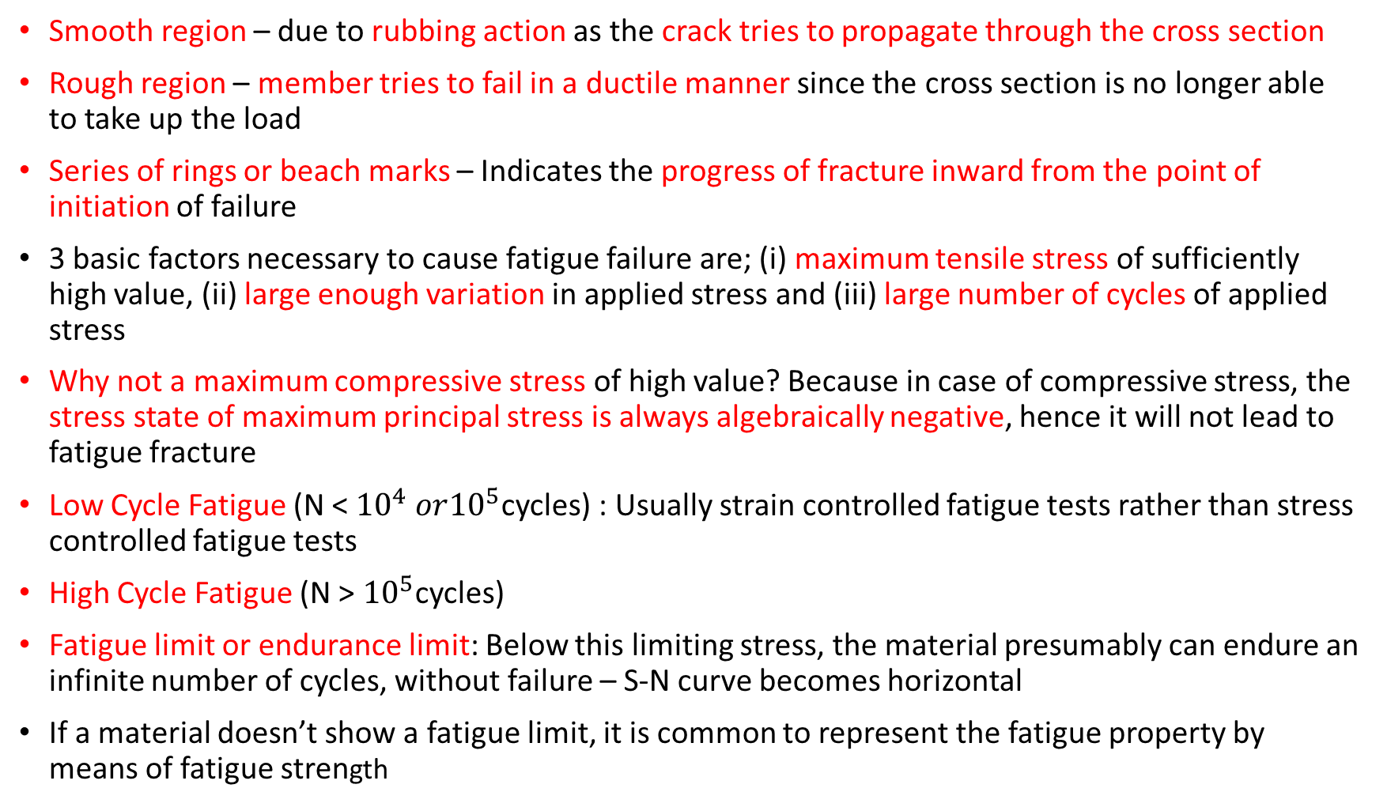
Introduction to Fatigue Contd.,
Smooth region – due to rubbing action as the crack tries to propagate through the cross section
Rough region – member tries to fail in a ductile manner since the cross section is no longer able to take up the load
Series of rings or beach marks – Indicates the progress of fracture inward from the point of initiation of failure
3 basic factors necessary to cause fatigue failure are; (i) maximum tensile stress of sufficiently high value, (ii) large enough variation in applied stress and (iii) large number of cycles of applied stress
Why not a maximum compressive stress of high value? Because in case of compressive stress, the stress state of maximum principal stress is always algebraically negative, hence it will not lead to fatigue fracture
Low Cycle Fatigue (N < ${10}^{4} or{10}^{5}$cycles) : Usually strain controlled fatigue tests rather than stress controlled fatigue tests
High Cycle Fatigue (N > ${10}^{5}$cycles)
Fatigue limit or endurance limit: Below this limiting stress, the material presumably can endure an infinite number of cycles, without failure – S-N curve becomes horizontal
If a material doesn’t show a fatigue limit, it is common to represent the fatigue property by means of fatigue strength

Slide 5
Variables that decide fatigue failure are..,
Stress concentration
Corrosion
Temperature
Overload
Metallurgical structure – example: inclusions
Microstructure
Composition
Residual stress
And the combinations of the above..,

Slide 6
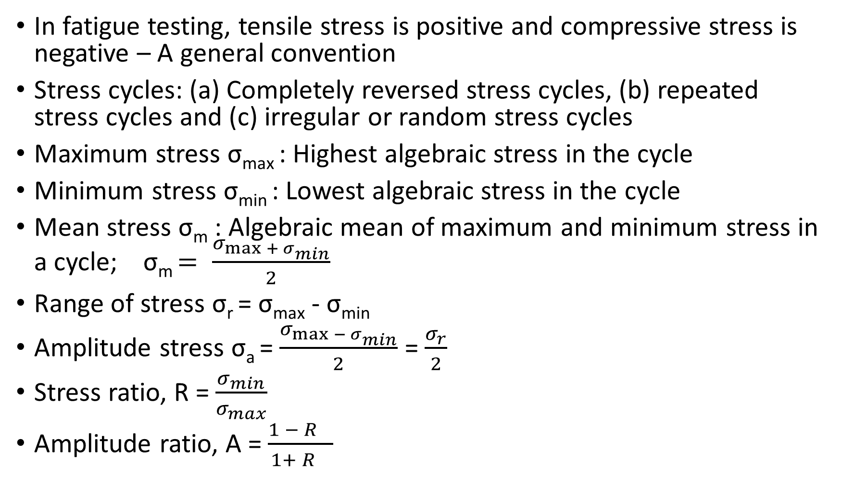
Fatigue testing parameters
In fatigue testing, tensile stress is positive and compressive stress is negative – A general convention
Stress cycles: (a) Completely reversed stress cycles, (b) repeated stress cycles and (c) irregular or random stress cycles
Maximum stress σ_{max} : Highest algebraic stress in the cycle
Minimum stress σ_{min} : Lowest algebraic stress in the cycle
Mean stress σ_{m} : Algebraic mean of maximum and minimum stress in a cycle; σ_{m} $= \frac{σ_{\max{+ σ_{min}}}}{2}$
Range of stress σ_{r} = σ_{max} - σ_{min}
Amplitude stress σ_{a} = $\frac{σ_{\max{− σ_{min}}}}{2}$ = $\frac{σ_{r}}{2}$
Stress ratio, R = $\frac{σ_{min}}{σ_{max}}$
Amplitude ratio, A = $\frac{{1 − R}_{}}{{1+ R}_{}}$

Slide 7
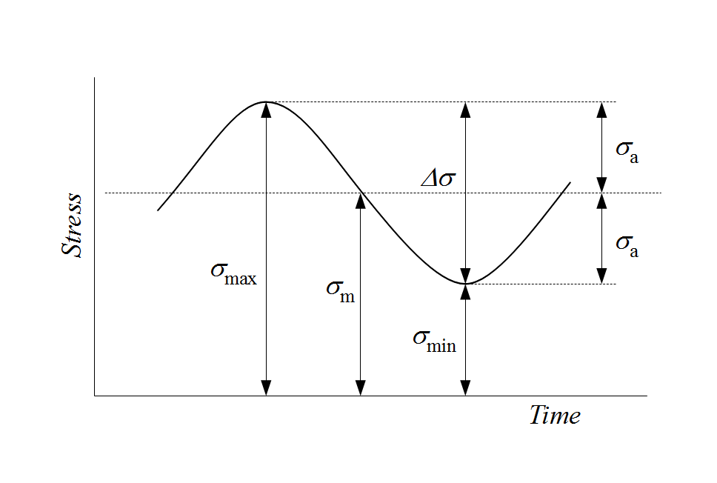
Completely reversed stress cycle
R.R Moore rotating beam fatigue machine – here a shaft rotates at constant speed without any peak overloads
Maximum (σ_{max}) and minimum stresses (σ_{min}) are equal

Slide 8
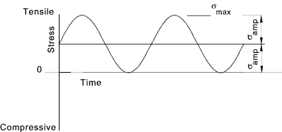
Repeated Stress Cycles
Here maximum and minimum stress are not equal
Repeated stress cycles can be in tension, compression and combination of both

Slide 9
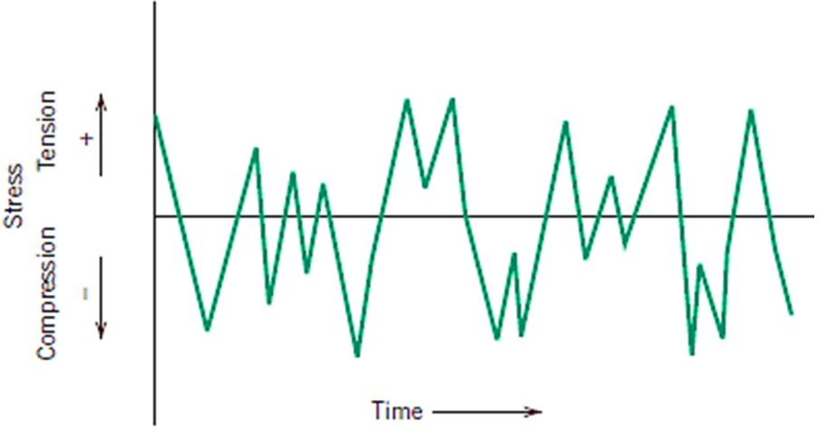
Irregular stress cycle
When a structural member is subjected to periodic unpredictable overloads due to gusts

Slide 10
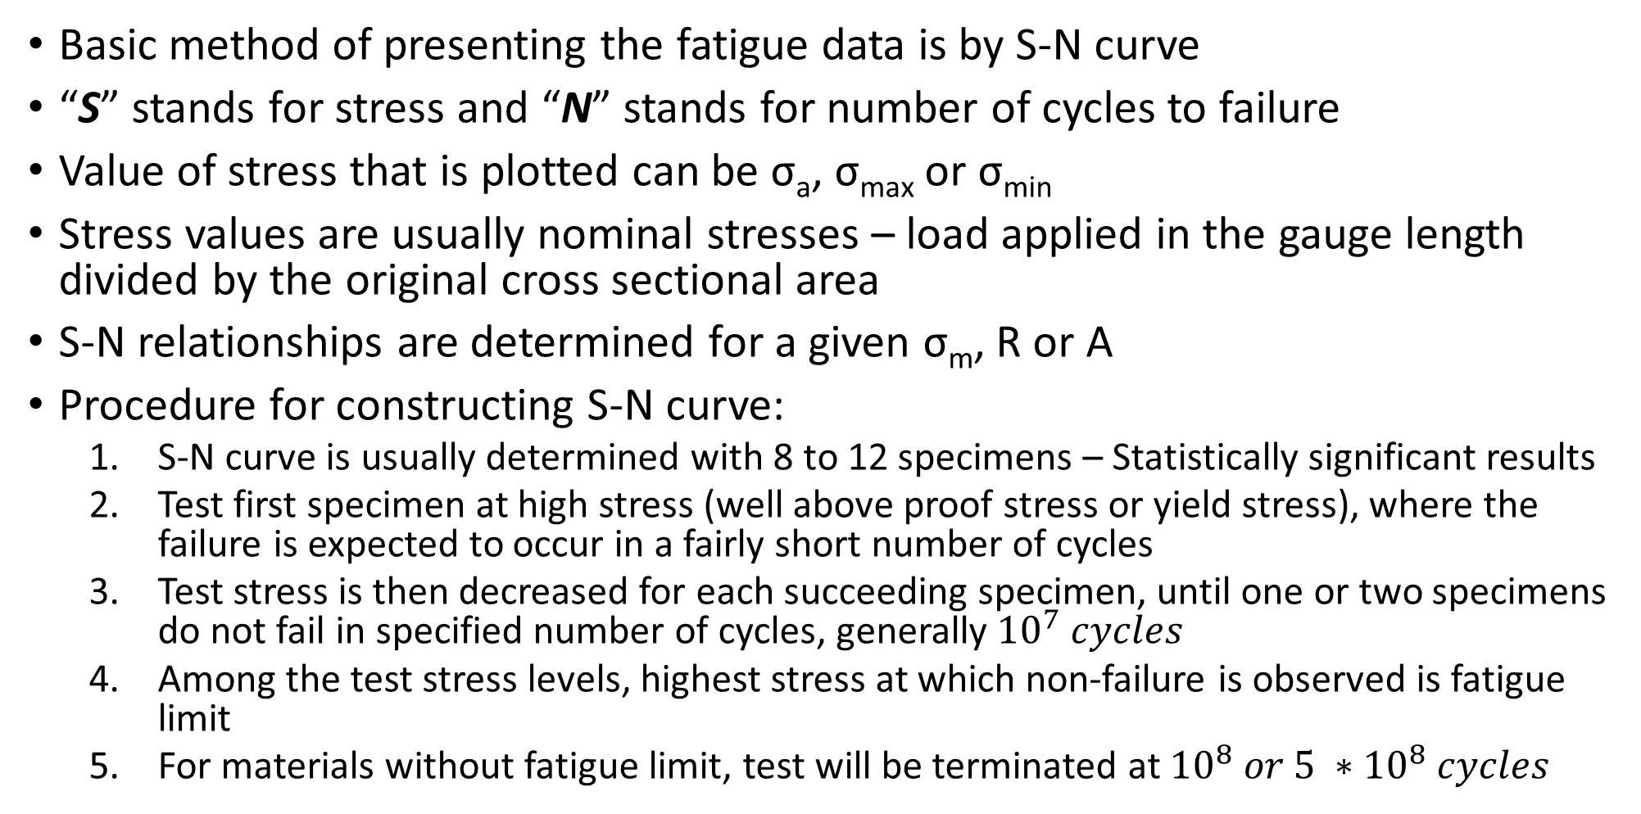
S-N Curve
Basic method of presenting the fatigue data is by S-N curve
“S” stands for stress and “N” stands for number of cycles to failure
Value of stress that is plotted can be σ_{a}, σ_{max} or σ_{min}
Stress values are usually nominal stresses – load applied in the gauge length divided by the original cross sectional area
S-N relationships are determined for a given σ_{m}, R or A
Procedure for constructing S-N curve:
S-N curve is usually determined with 8 to 12 specimens – Statistically significant results
Test first specimen at high stress (well above proof stress or yield stress), where the failure is expected to occur in a fairly short number of cycles
Test stress is then decreased for each succeeding specimen, until one or two specimens do not fail in specified number of cycles, generally ${10}^{7} cycles$
Among the test stress levels, highest stress at which non-failure is observed is fatigue limit
For materials without fatigue limit, test will be terminated at ${10}^{8} or 5 ∗{10}^{8} cycles$

Slide 11
Stress controlled fatigue tests
Here the stress amplitude is held constant during cycling
Stress ratio, “R” is maintained constant
It is done in 2 ways; (i) decreasing σ_{max} and maintain stress ratio constant (or by) (ii) decreasing alternate stress (σ_{a}) and maintain the mean stress (σ_{m}) constant
R is maintained constant by applying series of stress cycles with decreasing σ_{max} and by adjusting the σ_{min} the “R” value is maintained constant
When R is maintained constant, we will plot between σ_{max} vs N
Mean stress σ_{m} is kept constant by varying alternating stress, σ_{a}
When σ_{m} is maintained constant, we will plot between σ_{a} vs N
For different mean stress values (σ_{m}), different values of limiting range of stress (σ_{r}) is obtained: Goodman plots
Goodman diagram: Relationship between σ_{r} and σ_{m} during cyclic loading is given by GD
Variation in the range of stress (σ_{r}) as a function of mean stress (σ_{m})

Slide 12
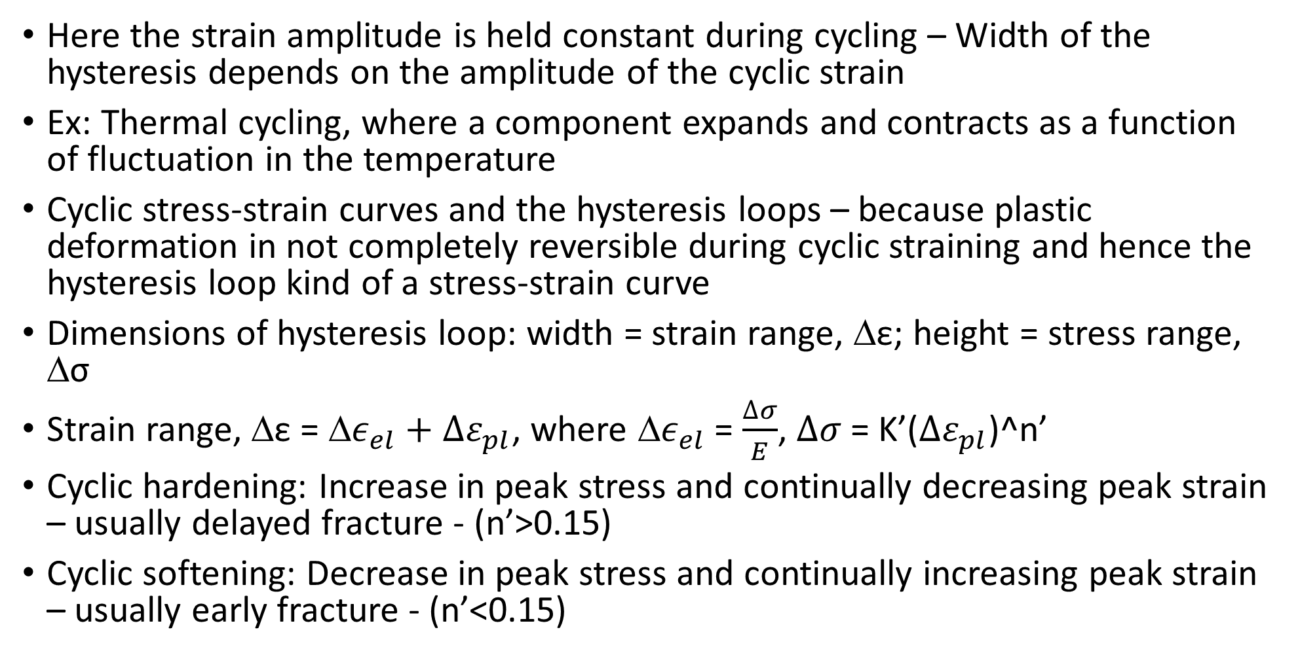
Strain controlled fatigue tests
Here the strain amplitude is held constant during cycling – Width of the hysteresis depends on the amplitude of the cyclic strain
Ex: Thermal cycling, where a component expands and contracts as a function of fluctuation in the temperature
Cyclic stress-strain curves and the hysteresis loops – because plastic deformation in not completely reversible during cyclic straining and hence the hysteresis loop kind of a stress-strain curve
Dimensions of hysteresis loop: width = strain range, Δε; height = stress range, Δσ
Strain range, Δε = Δ$ε_{el}+∆ε_{pl}$, where Δ$ε_{el}$ = $\frac{∆σ}{E}$, $∆σ$ = K’($∆ε_{pl}$)^n’
Cyclic hardening: Increase in peak stress and continually decreasing peak strain – usually delayed fracture - (n’>0.15)
Cyclic softening: Decrease in peak stress and continually increasing peak strain – usually early fracture - (n’<0.15)

Slide 13
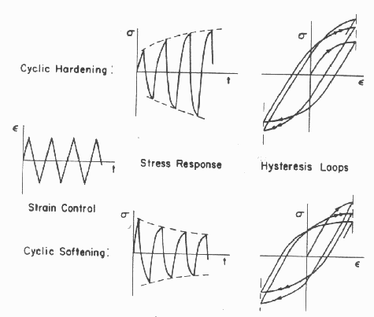
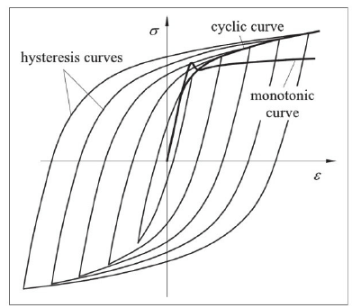
Cyclic stress-strain loop, cyclic hardening and softening

Slide 14
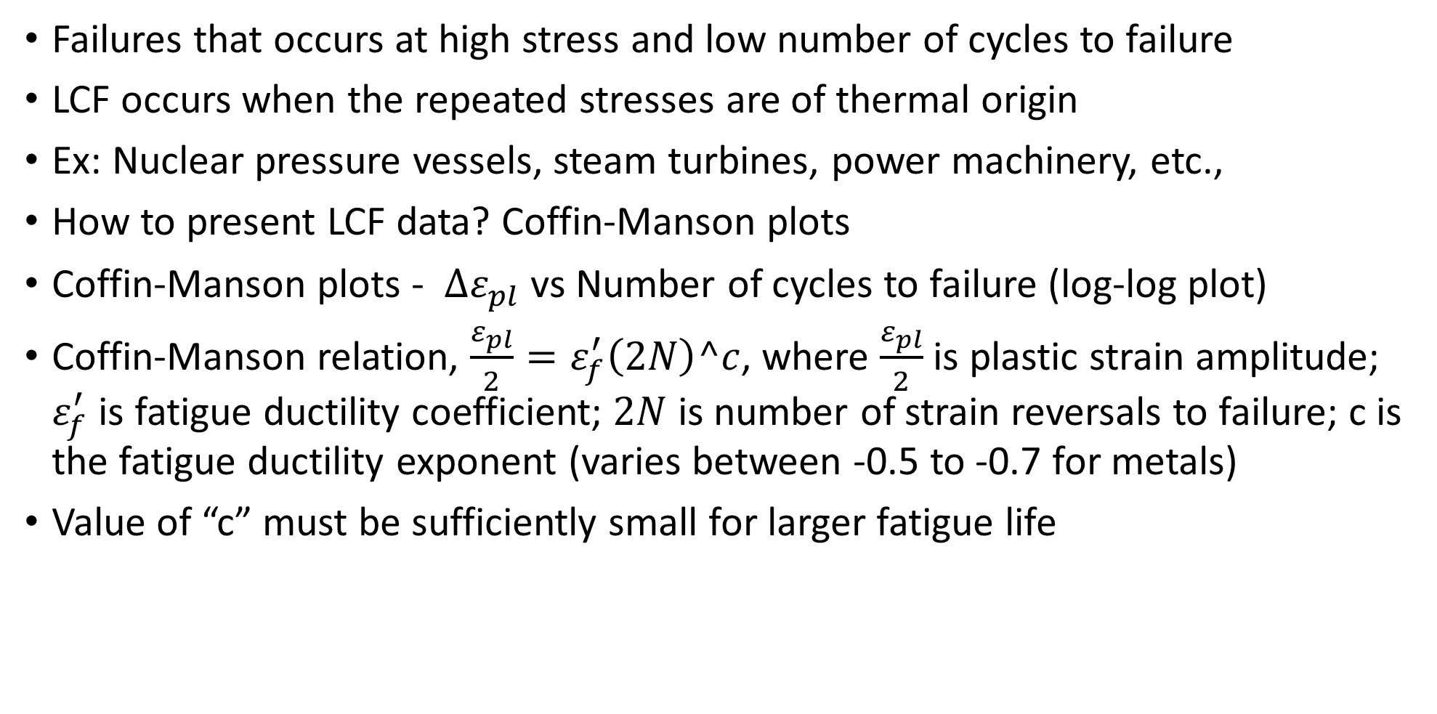
Low cycle fatigue (N < 10^4 to 10^5 cycles)
Failures that occurs at high stress and low number of cycles to failure
LCF occurs when the repeated stresses are of thermal origin
Ex: Nuclear pressure vessels, steam turbines, power machinery, etc.,
How to present LCF data? Coffin-Manson plots
Coffin-Manson plots - $∆ε_{pl}$ vs Number of cycles to failure (log-log plot)
Coffin-Manson relation, $\frac{ε_{pl}}{2}=ε_{f}^{′}\left(2N\right)^c$, where $\frac{ε_{pl}}{2}$ is plastic strain amplitude; $ε_{f}^{′}$ is fatigue ductility coefficient; $2N$ is number of strain reversals to failure; c is the fatigue ductility exponent (varies between -0.5 to -0.7 for metals)
Value of “c” must be sufficiently small for larger fatigue life

Slide 15
Structural changes during fatigue failure
Crack initiation – Early development of fatigue failure
Slip-band crack growth – Stage I crack growth - Deepening of initial crack on planes of high shear stress
Crack growth on planes of high tensile stress – Stage II crack growth - Growth of well defined crack in the direction normal to maximum tensile stress
Ultimate ductile fracture – Crack length increases beyond which cross section cannot support the applied load

Slide 16
Stage – I Fatigue crack growth
Generally fatigue crack growth starts at the surface
Formation of surface ridges and grooves – Slip-band extrusions and slip-band intrusions
Fatigue crack initiates at intrusions and extrusions
Slip bands are the result of systematic buildup of fine slip movements in the order of ~1 nm
Initially, slip band evolution acts as a sink for accommodating large total strain without appreciable cyclic strain hardening
Later, the slip band movement are prone to develop a slanting profile
Back and forth fine slip movements could form notches and ridges alternatively, at the surface
Every time a notch forms, it acts as a localized stress riser (of atomic dimensions) and paving the way for the start of fatigue crack growth
Generally the rate of crack growth in Stage-I is very low – nm per cycle

Slide 17
Stage – II Fatigue crack growth
Stage –II crack propagation rate is microns per cycle
Stage-II crack propagation frequency shows a ripples or fatigue striations
Stage-II crack propagation occurs by Plastic blunting process
At the start of loading cycle, crack tip will be sharp
Once the tensile load is applied, small double notch at crack tip concentrates the slip along the planes at 45° to the crack plane
As the crack widens to its maximum extension, crack propagates or deepens by PLASTIC SHEARING process and the crack tip becomes blunt
When the tensile load is changed to compression, slip direction in the end are reversed, crack faces will be crushed together
New crack surface is created again when the load becomes tensile and be crushed or blunted during the compression cycle

Slide 18
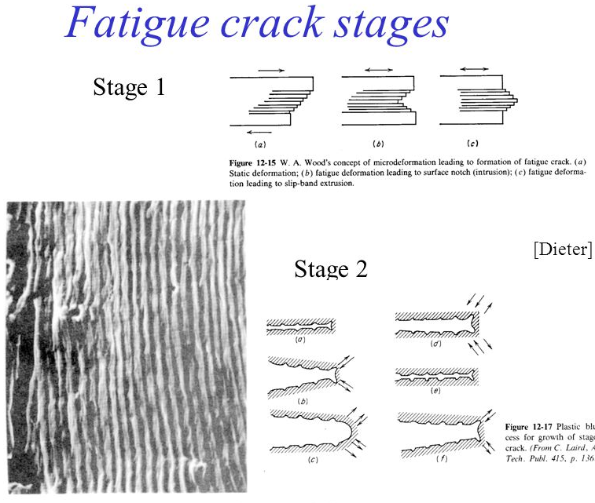
Insert W.A Woods concept of micro-deformation and plastic blunting process

Slide 19
Fatigue Testing and Standards
ASTM STANDARD E2714-13 – Specimen preparation, test procedure, etc.,
Whether it is a stress controlled or strain controlled fatigue test
Whether it is a triangular or trapezoidal waveform
If it is a stress controlled test, decide the nominal stress, hold time (if it is a dwell fatigue), rise time, fall time

